Slide 1
Mobile IP
Outline
  Intro to mobile IP
  Operation
  Problems with mobility

Slide 2
Mobile IP(Goals, Assumptions and Requirements)
The internet is the network for the global data communication with hundreds of millions of users. So, why can’t we use a mobile computer on the internet?
The reason is : you will not receive a single packet as soon as you leave your home network, i.e. the network your computer is configured for and reconnect your computer at another place if no additional mechanisms are available.
Consider the routing mechanism on internet :

Slide 3
Mobile IP(Goals, Assumptions and Requirements)
A host sends an IP packet with the header containing a destination address with other fields.
The destination address not only determines the receiver of the packet but also the physical subnet of the receiver.
For example; the destination address 129.13.42.99 shows that the receiver must be connected to the physical subnet with the network prefix 129.13.42.
Routers in the network now look at the destination addresses of incoming packets and forward them according to internal look-up tables.

Slide 4
Mobile IP(Goals, Assumptions and Requirements)
As long as the receiver can be reached within its physical subnet, it gets the packets; as soon as it moves outside the subnet, a packet will not reach it.
A quick solution to it can be to assign the computer a new topologically correct IP address with the help of DHCP(Dynamic host configuration protocol).
So moving to a new location would mean assigning a new IP address.
The problem is that nobody knows about this new address. It is almost impossible to find a (mobile) host on the internet which has just changed its address.

Slide 5
Mobile IP(Goals, Assumptions and Requirements)
With the help of dynamic DNS( DDNS) an update of the mapping logical name – IP address is possible.
This is what many computer users do if they have a dynamic IP address and still want to be permanently reachable using the same logical computer name.
But these considerations are important if a user wants to offer services from a mobile node, i.e. the node is a server.
The problem with dynamically adapting the IP address with regard to the current location is that the domain name system (DNS) needs some time before it updates the internal tables necessary to map a logical name to an IP address.

Slide 6
Mobile IP(Goals, Assumptions and Requirements)
This approach does not work if the mobile node moves quite often.
The internet and the DNS have not been built for frequent updates.
There are several requirements accompanied with the development of the standard :
Compatibility : No changes can be introduced for applications or network protocols already in use since there is a huge base of internet computers. Mobile IP has to be integrated into existing operating systems or at least work with them. (today its available for many platforms).

Slide 7
Mobile IP(Goals, Assumptions and Requirements)
Routers within the internet should not necessarily require other software. While it is possible to enhance the capabilities of some routers to support mobility, its impossible to change all of them.
Mobile IP has to remain compatible with all lower layers used for the standard, non-mobile, IP.
End systems enhanced with a mobile IP implementation should still be able to communicate with fixed systems without mobile IP.

Slide 8
Mobile IP(Goals, Assumptions and Requirements)
Transparency : Mobility should remain invisible for many higher layer protocols and applications.
Besides noticing a lower bandwidth and some interruption in service, higher layers should continue to work even if the mobile computer has changed its point of attachment to the network.
Scalability and Efficiency: Introducing a new mechanism should not jeopardize its efficiency. Enhancing IP for mobility must not generate too many messages flooding the whole network. Special care has to be taken considering the lower bandwidth of wireless links.

Slide 9
Mobile IP(Goals, Assumptions and Requirements)
Security : Mobility poses many security problems. The minimum requirement is that of all the messages related to the management of Mobile IP are authenticated.
The IP layer must be sure that if it forwards a packet to a mobile host that this host receives the packet.
The IP layer can only guarantee that the IP address of the receiver is correct.
The goal of a mobile IP can be summarized as :
“supporting end-system mobility while maintaining scalability, efficiency and compatibility in all respects with existing applications and Internet protocols”.

Slide 10
Mobility and Standard IP Routing
IP assumes end hosts are in fixed physical locations
IP addresses enable IP routing algorithms to get packets to the correct network
  IP address has network part and host part
  Host part should not be in routing tables
What if a user roams between networks?
  Want transparency
  Routing information becomes invalid
  Why can’t mobile users change IP when running an application?

Slide 11
Mobile IP
Developed as a means for transparently dealing with problems of mobile users
Enables hosts to stay connected to the Internet regardless of their location and without changing IP addresses
Requires no changes to software of non-mobile hosts/routers
Requires addition of some infrastructure
Has no geographical limitations
Requires no modifications to IP addresses
Supports security

Slide 12
Mobile IP Entities
Mobile Node (MN)
  The entity that moves from network to network
  Assigned a permanent IP called its home address to which other hosts send packets regardless of MN’s location
  A mobile node is an end-system that can change its point of attachment to the internet using mobile IP.
  It need not necessarily be the device such as laptops or mobile phones. It can be a router onboard an aircraft which can be a powerful mobile node.

Slide 13
Mobile IP Entities
Home Network : The home network is the subnet the MN belongs to with respect to its IP address. No mobile IP support is needed with the home network.
Foreign network : the foreign network is the current subnet the MN visits and which is not the home network.
Foreign Agent (FA)
  Another router with enhanced functionality
  Used to send/receive data between MN and HA
  Advertises itself periodically

Slide 14
Mobile IP Entities contd.
Care-of-address (COA)
  Address which identifies MN’s current location
  All IP packets sent to MN are delivered to the COA, not directly to the IP address of the MN.
  Sent by FA to HA when MN attaches
  Usually the IP address of the FA (called Foreign agent COA where COA is located at the FA)
Correspondent Node (CN)
  End host to which MN is corresponding (eg. a web server)
  It can be a fixed or mobile node.

Slide 15
Mobile IP Entities contd.
Home Agent (HA)
  Router with additional functionality
  Located on home network of MN
  Mobility binding of MN’s IP with its Care of Address (COA)
  ( HA maintains a location registry, i.e. it is informed of the MN’s location by the current COA.)
  Forwards packets to appropriate network when MN is away – uses encapsulation.

Slide 16
Overview
COA
foreign
network
home
network
router
HA
router
FA
MN
Internet
CN
router
Fig 1
3.
foreign
network
home
network
router
HA
router
FA
MN
2.
4.
Internet
1.
CN
router
Fig 2

Slide 17
IP packet delivery
Fig 2 illustrates the packet delivery to and from the MN.
A correspondent node CN wants to send an IP packet to the MN. One of the requirements of mobile IP was to support hiding the mobility of the MN.
CN does not need to know anything about the MN’s current location and sends the packet as usual to the IP address of MN (Step 1).
This means that CN sends an IP packet with MN as a destination address and CN as a source address.
The internet, not having the information on the current location of MN, routes the packet to the router responsible for the home network of MN.

Slide 18
IP packet delivery
The HA now intercepts the packet, knowing that the MN is currently not in its home network.
The packet is not forwarded into the subnet as usual, but encapsulated and tunnelled to the COA.
A new header is put in front of the old IP header showing the COA as new destination and HA as soruce of the encapsulated packet (Step 2).
The foreign agent now decapsulates the packet, i.e. removes the additional header and forward the original packet with CN as source and MN as destination to the MN (Step 3).

Slide 19
IP packet delivery
Again, for the MN mobility is not visible.
It receives the packet with the same sender and receiver address as it would have done in the home network.

Slide 20
Mobile IP Support Services
Agent Discovery
  HA’s and FA’s broadcast their presence on each network to which they are attached
  MN’s listen for advertisement and then initiate registration
Registration
  When MN is away, it registers its COA with its HA, via FA
  Registration control messages sent via UDP to well known port
Encapsulation/decapsulation – just like standard IP only with COA

Slide 21
Mobile IP Operation
A MN listens for agent advertisement and then initiates registration
  If responding agent is the HA, then mobile IP is not necessary
After receiving the registration request from a MN, the HA acknowledges and registration is complete
  Registration happens as often as MN changes networks
HA intercepts all packets destined for MN
  This is simple unless sending application is on or near the same network as the MN
  HA masquerades as MN
  There is a specific lifetime for service before a MN must re-register
  There is also a de-registration process with HA if an MN returns home

Slide 22
Agent advertisement
0
7
8
15
16
23
24
31
type
code
checksum
#addresses
addr. size
lifetime
router address 1
preference level 1
router address 2
preference level 2
type = 16
length = 6 + 4 * #COAs
R: registration required
B: busy, no more registrations
H: home agent
F: foreign agent
M: minimal encapsulation
G: GRE encapsulation
r: =0, ignored (former Van Jacobson compression)
T: FA supports reverse tunneling
reserved: =0, ignored
. . .
type
length
sequence number
registration lifetime
R
B
H
F
M
G
V
reserved
COA 1
COA 2
. . .

Slide 23
Agent advertisement
The agent advertisement packet according to RFC 1256 with the extension for mobility is shown earlier.
The upper part represents the ICMP packet while the lower part is the extension needed for mobility.
The IP destination address according to standard router advertisements can be either set to 224.0.0.1, which is the multicast address for all systems on a link or to the broad cast address 255.255.255.255.
The fields in the ICMP are defined as follows :
The type is set to 9, the code can be 0, if the agent also routes traffic from non-mobile nodes, or 16 if it does not route anything other than mobile traffic.

Slide 24
Agent advertisement
The number of addresses advertised with this packet is in #addresses.
Lifetime denotes the length of time this advertisement is valid.
Reference levels for each address help a node to choose the router that is the most eager one to get a new node.
The extension for mobility has the following fields defined :
Type is set to 16, length depends on the number of COAs provided with the message and equals 6+4*(number of address).
An agent shows the total number of advertisements sent since initialization in the sequence number.
By the registration lifetime the agent can specify the maximum lifetime in seconds a node can request during registration.

Slide 25
Agent advertisement
The R bit (registration) shows, if a registration with this agent is required even when using a colocated COA at the MN.
If the agent is currently too busy to accept new registrations it can set the B bit.
The following two bits denote if the agent offers services as a home agent (H) or foreign agent (F) on the link where the advertisement has been sent.
Bits M and G specify the method encapsulation.
M : Minimal encapsulation
G : Generic routing encapsulation

Slide 26
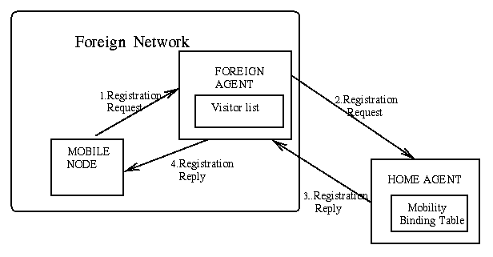
Registration Process

Slide 27
Mobile IP registration request
0
7
8
15
16
23
24
31
type
S
B
D
M
G
r
T
x
lifetime
home address
home agent
COA
identification
extensions . . .
S: simultaneous bindings
B: broadcast data grams
D: de capsulation by MN
M: minimal encapsulation
G: GRE encapsulation
r: =0, ignored
T: reverse tunnelling requested
x: =0, ignored

Slide 28
Mobile IP registration request
The MN sends its registration request containing the COA to the FA which is forwarding the request to the HA.
The HA now sets up a mobility binding containing the mobile node’s home IP address and the current COA.
The mobility binding contains the lifetime of the registration which is negotiated during the registration process.
Registration

Slide 29
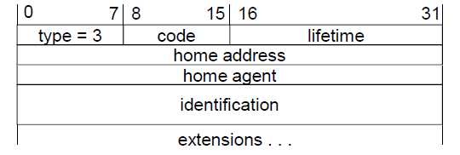
Mobile IP registration reply
Example codes:
registration successful
  0 registration accepted
  1 registration accepted, but simultaneous mobility bindings unsupported
registration denied by FA
  65 administratively prohibited
  66 insufficient resources
  67 mobile node failed authentication
  68 home agent failed authentication
  69 requested Lifetime too long
registration denied by HA
  129 administratively prohibited
  131 mobile node failed authentication
  133 registration Identification mismatch
  135 too many simultaneous mobility bindings

Slide 30
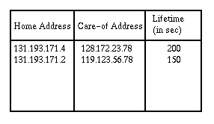
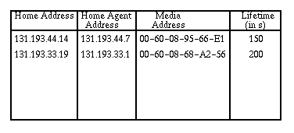
Tables maintained on routers
Mobility Binding Table
  Maintained on HA of MN
  Maps MN’s home address with its current COA
Visitor List
  Maintained on FA serving an MN
  Maps MN’s home address to its MAC address and HA address

Slide 31
Mobile IP Operation contd.
HA then encapsulates all packets addressed to MN and forwards them to FA
  IP tunneling
FA decapsulates all packets addressed to MN and forwards them via hardware address (learned as part of registration process)
Bidirectional communications require tunneling in each direction

Slide 32
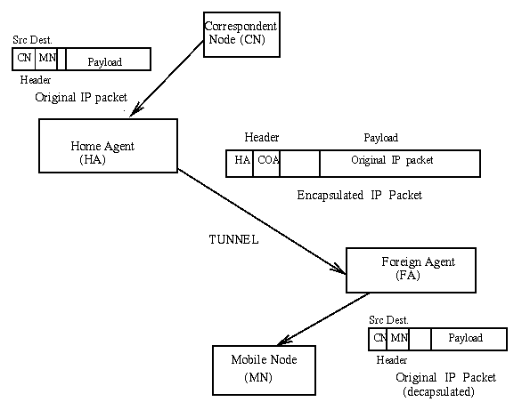
Mobile IP Tunneling
Across Internet

Slide 33
Routing/Tunneling
Routing a packet to a MN involves the following:
  A router on the home link, possibly the HA, advertises reachability to the network prefix of the MN’s home address.
  All packets are therefore routed to the MN’s home link.
  A HA intercepts the packets for the MN and tunnels a copy to each COA in the binding table.
  At the foreign link either the MN extracts the packet (collocated COA) or the FA extracts the packet and forwards it to the MN.

Slide 34
Routing/Tunneling
How does a MN route its packets?
  It needs to find a router to send all its packets to.
  It can select a router in one of a number of ways dependent upon whether it has a FA COA or a collocated COA.
  Having a FA COA does not imply that the MN needs to use it as its default router for sending packets. It can use any router that sends advertisements or that is advertised in the Agent Advertisement message.
  If the MN is using a collocated COA it needs to listen for router advertisements or if it hears none, use DHCP to find the default router.

Slide 35
Encapsulation Process
original IP header
original data
new IP header
new data
outer header
inner header
original data

Slide 36
Types of Encapsulation
Three types of encapsulation protocols are specified for Mobile IP:
  IP-in-IP encapsulation: required to be supported. Full IP header added to the original IP packet. The new header contains HA address as source and Care of Address as destination.
  Minimal encapsulation: optional. Requires less overhead but requires changes to the original header. Destination address is changed to Care of Address and Source IP address is maintained as is.
  Generic Routing Encapsulation (GRE): optional. Allows packets of a different protocol suite to be encapsulated by another protocol suite.
Type of tunneling/encapsulation supported is indicated in registration.

Slide 37
Routing techniques
Triangle Routing: tunneling in its simplest form has all packets go to home network (HA) and then sent to MN via a tunnel.
  This involves two IP routes that need to be set-up, one original and the second the tunnel route.
  Causes unnecessary network overhead and adds to the latency.
Route optimization: allows the correspondent node to learn the current location of the MN and tunnel its own packets directly. Problems arise with
  mobility: correspondent node has to update/maintain its cache.
  authentication: HA has to communicate with the correspondent node to do authentication, i.e., security association is with HA not with MN.

Slide 38
Optimization of packet forwarding
Change of FA
  packets on-the-fly during the change can be lost
  new FA informs old FA to avoid packet loss, old FA now forwards remaining packets to new FA
  this information also enables the old FA to release resources for the MN

Slide 39
Change of foreign agent
CN
HA
FA_{old}
FA_{new}
MN
request
update
ACK
data
data
MN changes
location
registration
registration
update
ACK
data
data
data
warning
update
ACK
data
data
t

Slide 40
Mobile IP and IPv6
Mobile IP was developed for IPv4, but IPv6 simplifies the protocols
  security is integrated and not an add-on, authentication of registration is included
  COA can be assigned via auto-configuration (DHCPv6 is one candidate), every node has address auto configuration
  no need for a separate FA, all routers perform router advertisement which can be used instead of the special agent advertisement
  MN can signal a sender directly the COA, sending via HA not needed in this case (automatic path optimization)
  “soft” hand-over, i.e. without packet loss, between two subnets is supported
    MN sends the new COA to its old router
    the old router encapsulates all incoming packets for the MN and forwards them to the new COA
    authentication is always granted

Slide 41
Security in Mobile IP
Authentication can be performed by all parties
  Only authentication between MN and HA is required
  Keyed MD5 is the default
Replay protection
  Timestamps are mandatory
  Random numbers on request reply packets are optional
HA and FA do not have to share any security information.

Slide 42
Problems with Mobile IP
Suboptimal “triangle” routing
  What if MN is in same subnetwork as the node to which it is communicating and HA is on the other side of the world?
    It would be nice if we could directly route packets
  Solution: Let the CN know the COA of MN
    Then the CN can create its own tunnel to MN
    CN must be equipped with software to enable it to learn the COA
    Initiated by HA who notifies CN via “binding update”
    Binding table can become stale

Slide 43
Problems with Mobile IP
Single HA model is fragile
  Possible solution – have multiple HA
Frequent reports to HA if MN is moving
  Possible solution – support of FA clustering
Security
  Connection hijacking, snooping…
Many open research questions

Slide 44
Mobility in IPv6
Route Optimization is a fundamental part of Mobile IPv6
  Mobile IPv4 it is an optional set of extensions that may not be supported by all nodes
Foreign Agents are not needed in Mobile IPv6
  MNs can function in any location without the services of any special router in that location
Security
  Nodes are expected to employ strong authentication and encryption

Slide 45
IP Micro-mobility support
• Micro-mobility support:
  • Efficient local handover inside a foreign domain without involving a home agent
  • Reduces control traffic on backbone
  • Especially needed in case of route optimization
• Example approaches (research not products):
  • Cellular IP
  • HAWAII
  • Hierarchical Mobile IP (HMIP)
• Important criteria:
  Security Efficiency, Scalability, Transparency, Manageability

Slide 46
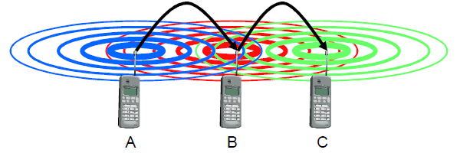
Mobile ad hoc networks
Standard Mobile IP needs an infrastructure
  • Home Agent/Foreign Agent in the fixed network
  • DNS, routing etc. are not designed for mobility
• Sometimes there is no infrastructure!
  • remote areas, ad-hoc meetings, disaster areas
  • cost can also be an argument against an infrastructure!
• Main topic: routing
  • no default router available
  • every node should be able to forward

Slide 47
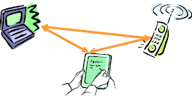

Solution: Wireless ad-hoc networks
• Network without infrastructure
• Use components of participants for networking
• Examples
• Single-hop: All partners max. one hop apart
  • Bluetooth piconet, PDAs in a room, gaming devices…
• Multi-hop: Cover larger distances,
circumvent obstacles
  • Bluetooth scatternet, TETRA police network, car-to-car networks…
• Internet: MANET (Mobile Ad-hoc Networking) group

